Slide 1
Welcome!
Sunday
Bible Study 9:30 AM
Worship 10:30 AM
Wednesday
Bible Class 7:00 PM
www.SunsetchurchofChrist.net

Slide 2
John 17
Pt 1 – a prayer for the Son
To be glorified
Pt 2 – a prayer for the Apostles
To be sanctified
Pt 3 – a prayer for all believers
To be unified

Slide 3
Welcome!
Sunday
Bible Study 9:30 AM
Worship 10:30 AM
Wednesday
Bible Class 7:00 PM
www.SunsetchurchofChrist.net

Slide 4
Opening Prayer | Steven James
Song – | Grant Haines
Scripture Reading | Anthony Ward
Song – | Grant Haines
Song – | Grant Haines
Lord’s Supper | Anthony Ward / Lamar McDonald
Song – | Grant Haines
Collection | Anthony Ward / Lamar McDonald
Song – | Grant Haines
Lesson | Brian Haines
Song – | Grant Haines
Closing | Ryan Sollars

Slide 5
Working Out
Your OWN
Salvation
Philippians 2:12
Notes:
Php 2:12 ¶ Therefore, my beloved, as you have always obeyed, not as in my presence only, but now much more in my absence, work out your own salvation with fear and trembling;

Slide 6
Ownership in Business
“Taking ownership is about taking initiative. We take ownership when we believe that taking action is not someone else’s responsibility. You, as an individual, are accountable for the quality and timeliness of an outcome, even when you’re working with others. You care about the outcome the same way you would care as an owner of the organization” Modern Manager, March 2017

Slide 7
Ownership in Salvation
Taking initiative
Not someone else’s responsibility
Accountable for quality and timeliness
You care as the owner cares

Slide 8
Taking Initiative in Salvation
Action to improve your salvation
2 Peter 1:10-11
Preparing yourself to overcome trials
Ephesians 2:10-18
Notes:
2Pe 1:10 Therefore, brethren, be all the more diligent to make certain about His calling and choosing you; for as long as you practice these things, you will never stumble; 11 for so an entrance will be supplied to you abundantly into the everlasting kingdom of our Lord and Savior Jesus Christ.
Eph 6:10 ¶ Finally, my brethren, be strong in the Lord and in the power of His might. 11 Put on the whole armor of God, that you may be able to stand against the wiles of the devil. 12 For we do not wrestle against flesh and blood, but against principalities, against powers, against the rulers of the darkness of this age, against spiritual hosts of wickedness in the heavenly places. 13 Therefore take up the whole armor of God, that you may be able to withstand in the evil day, and having done all, to stand. 14 Stand therefore, having girded your waist with truth, having put on the breastplate of righteousness, 15 and having shod your feet with the preparation of the gospel of peace; 16 above all, taking the shield of faith with which you will be able to quench all the fiery darts of the wicked one. 17 And take the helmet of salvation, and the sword of the Spirit, which is the word of God; 18 praying always with all prayer and supplication in the Spirit, being watchful to this end with all perseverance and supplication for all the saints--

Slide 9
Not Another’s Responsibility
The church CANNOT save you
You are not saved being in a good church
A church with good elders & preacher
A church with a good reputation
Revelation 2-3

Slide 10
Not Another’s Responsibility
The church CANNOT save you
You are not saved being in a good church
You are saved by obedient faith
Through hearing – Acts 11:14
Loving the truth – 2 Thes. 2:10
Notes:
2Th 2:10 and with all the deception of wickedness for those who perish, because they did not receive the love of the truth so as to be saved.
Ac 11:14 and he will speak words to you by which you will be saved, you and all your household.'

Slide 11
Not Another’s Responsibility
The church CANNOT save you
You are not saved being in a good church
You are saved by obedient faith
You cannot blame others for failing
1 Kings 13
Notes:
2Th 2:10 and with all the deception of wickedness for those who perish, because they did not receive the love of the truth so as to be saved.
Ac 11:14 and he will speak words to you by which you will be saved, you and all your household.'

Slide 12
Being Accountable
Seen in the parable of the talents – Luke 19:12
Accountable for:
Time
Blessings
Ability
Opportunity
Notes:
Seven times in Genesis 1 God calls the creation good
Ge 1:4 And God saw the light, that it was good; and God divided the light from the darkness.
De 6:24 'And the LORD commanded us to observe all these statutes, to fear the LORD our God, for our good always, that He might preserve us alive, as it is this day.

Slide 13
Caring as the Owner
What does our Supervisor want?
1. All men to be saved
2. Our brethren to remain faithful
3. Our lights to shine in darkness
4. We endure until the end

Slide 14
Caring as the Owner
What does our Supervisor want?
What do you want?
1. All men to be saved
2. Our brethren to remain faithful
3. Our lights to shine in darkness
4. Endure until the end

Slide 15
Work Out Your Salvation
For we are His workmanship, created in Christ Jesus for good works, which God prepared beforehand that we should walk in them. Ephesians 2:10

Slide 16
Work Out Your Salvation
What are the works prepared?
Ephesians 4:24-6:9
Godly conduct
Love for one another
Relationships with others

Slide 17
Conclusions
Owning the salvation you work out:
Taking responsibility
Not making excuses
Not blaming others
Finding what works you must do
Having a love for God and one another

Slide 19
Where Are You Going
Heaven and Hell are up to you
You choose to believe what you heard
You choose to confess that belief
You choose to repent
You choose to be baptized
You choose to remain faithful

Slide 20
Sunset Church of Christ
Financial report May 2022

Slide 21
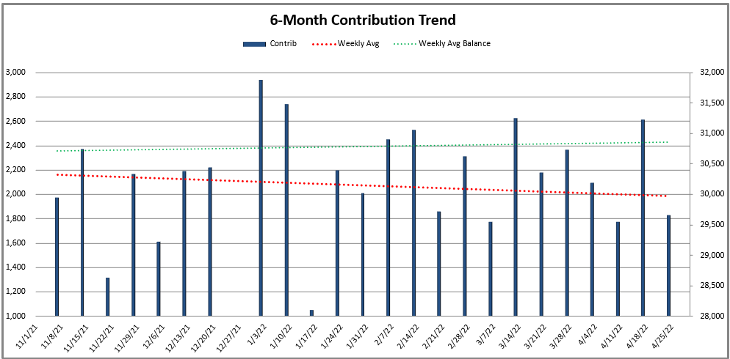
Last 3 month avg contribution ~$2,196/wk
2021 avg contribution ~$2,098/wk
Last 3 month avg balance ~$30,964
2021 avg balance ~$33,738

Slide 22
Apr-2022 Itemized
Beginning Balance (April 1, 2022) |  |  | $ 31,015.83
Deposits |  | $ 8,306.10 | $ 39,321.93
Expenses | $ (8,388.60)
Rent | $ (3,669.40)
Brian Haines | $ (4,622.00)
Other (Electric, Water, Garbage/Recycling, Building) | $ (97.20)
Ending Balance (April 30, 2022) |  |  | $ 30,933.33

Slide 23
Mar-2022 Itemized
Beginning Balance (March 1, 2022) |  |  | $ 30,553.15
Deposits |  | $ 8,939.35 | $ 39,492.50
Expenses | $ (8,476.67)
Rent | $ (3,669.40)
Brian Haines | $ (4,622.00)
Other (Electric, Water, Garbage/Recycling, Building) | $ (185.27)
Ending Balance (March 31, 2022) |  |  | $ 31,015.83

Slide 24
Feb-2022 Itemized
Beginning Balance (February 1, 2022) |  |  | $ 27,799.42
Deposits |  | $ 11,158.99 | $ 38,958.41
Expenses | $ (8,405.26)
Rent | $ (3,669.40)
Brian Haines | $ (4,622.00)
Other (Electric, Water, Garbage/Recycling, Building) | $ (113.86)
Ending Balance (February 28, 2022) |  |  | $ 30,553.15

Slide 25
Backup

Slide 26
Meeting location
Current rent to 5/31/2022: $3,394 + $275.40 (NNN) = $3,669.40
3,060 sq ft $1.20/sq ft/month $14.34/sq ft/year
Auditorium seating ~100 attendees
4 classrooms, restrooms (mens and womens) and ample parking
Response options current landlord:
Month-to-month rental from landlord – estimated ~$100/month or 3% annual increase – request 60 day notice to vacate and property left “as is”
Renew current lease for 36 months – estimated $100/month or 3% annual increases same as previous

Slide 27
Jan-2022 Itemized
Beginning Balance (January 1, 2022) |  |  | $ 27,747.91
Deposits |  | $ 8,918.53 | $ 36,666.44
Expenses | $ (8,867.02)
Rent | $ (3,669.40)
Brian Haines | $ (4,922.00)
Other (Electric, Water, Garbage/Recycling, Building) | $ (275.62)
Ending Balance (January 31, 2022) |  |  | $ 27,799.42

Slide 28
Dec-2021 Itemized
Beginning Balance (December 1, 2021) |  |  | $ 30,442.38
Deposits |  | $ 6,022.00 | $ 36,464.38
Expenses | $ (8,716.47)
Rent | $ (3,669.40)
Brian Haines | $ (4,922.00)
Other (Electric, Water, Garbage/Recycling, Building) | $ (125.07)
Ending Balance (December 30, 2021) |  |  | $ 27,747.91

Slide 29
Nov-2021 Itemized
Beginning Balance (November 1, 2021) |  |  | $ 29,340.18
Deposits |  | $ 9,802.40 | $ 39,142.58
Expenses | $ (8,700.20)
Rent | $ (3,669.40)
Brian Haines | $ (4,922.00)
Other (Electric, Water, Garbage/Recycling, Building) | $ (108.80)
Ending Balance (November 30, 2021) |  |  | $ 30,442.38

